Slide 1
Api Marketplace “Mutual Funds”
1 | Description
2 | Terminologies
3 | Key Features
4 | Process Workflow
5 | Key Inputs/Outputs

Slide 2
Description

Slide 3
Descriptions
What is the API Marketplace?
A Centralized platform to expose APIs for mutual fund investments.
Enables ARB subsidiaries to offer mutual fund services through their digital channels.
What is a Mutual Fund?
Mutual Fund: A pooled investment managed by professionals, offering investors proportional ownership of a diversified portfolio.
What Mutual Funds Do:
Allow investors to subscribe (buy) units and redeem (Sell) units
How It Will Be Used (B2B):
Your business (Consumer) integrates with API Marketplace to offer these services to your customers.
Advantages of Mutual Funds (Business View):
Expand product offerings without building your own investment platform.
Quick time to market through standardized APIs.
Multiple risk level options for customer choice.
How It Works (Business Flow):
Your platform presents fund products, manages subscriptions/redemptions, and provides performance tracking to end customers.

Slide 4
Terminologies

Slide 5
Terminologies- Business Definitions
Mutual Fund | An investment product where multiple parties contribute capital into a professionally managed pool, providing diversified asset exposure.
Subscription | The process of committing funds to acquire a proportional share in the investment pool.
Redemption | The act of withdrawing part or all of the invested share in exchange for its current value.
Portfolio Management | The oversight and reporting of invested holdings, including performance tracking and valuation updates.
Portfolio Holdings | The detailed record of all investment units owned by a customer, including fund names, quantities, acquisition dates, and related attributes, representing their current positions in the investment pool.
Portfolio Performance | The measurement and reporting of how a customer’s holdings have changed in value over time, including gains, losses, dividends, and overall return, enabling informed investment decisions.

Slide 6


Key Features – Business Perspective

Slide 7
Key Features
1. Subscription Capabilities
Access to a complete and up-to-date catalogue of available funds with relevant attributes
Automated eligibility and suitability checks before allowing an investment.
Flexible investment amounts based on the fund’s minimum and maximum thresholds.
Immediate confirmation of successful subscriptions with unique transaction IDs.
2. Redemption Capabilities
Ability to request partial or full withdrawal from owned funds.
Handling of settlement timelines according to the fund’s operational rules.
Status tracking from request initiation to completion.
3. Portfolio Management
Consolidated view of all customer holdings across multiple funds.
Real-time updates of fund quantities, valuations, and asset composition.
Exportable reports for compliance and record-keeping.
4. Reporting & Notifications
Transaction summaries for subscriptions and redemptions.
Periodic performance statements for each customer portfolio.
Alerts for key events such as NAV changes, dividend distributions, or fund suspensions.

Slide 8
Process Workflow

Slide 9
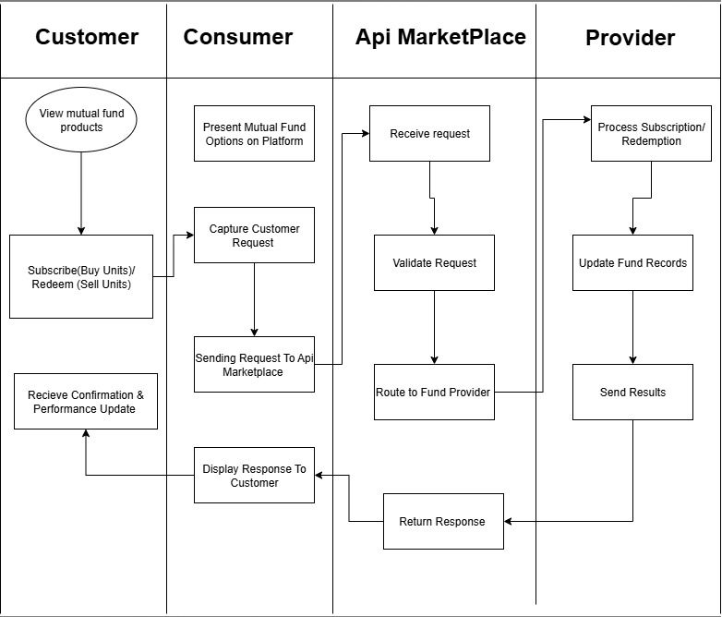

Slide 10
Use Cases
Customer
Request subscription/redemption
Consumer
Forward request
API Marketplace
Validate & secure
Provider
Execute transaction
Send results
Route to Provider
Display updates
Receive confirmation

Slide 11
Inputs & Outputs – Business Keys

Slide 12
Purpose: Explain what the client needs to provide and what they will get from the APIs.
Inputs (Business Perspective):
Customer identification details.
Fund selection and subscription/redemption details.
Payment/wallet information.
Risk assessment questionnaire responses.
Outputs (Business Perspective):
Fund details and pricing data.
Subscription/redemption confirmation and status.
Portfolio summaries and performance reports.
Notifications on transactions and dividends.

